Slide 1
PSYC10009: Biological Psychology
Dr David Turk

Slide 2
Lecture 10: The Biology of Emotion
Reading:
Kalat, Chapter 12
Schacter, Chapter 10

Slide 3
Measuring Emotion
What is an emotion?
“An internal process that modifies the way an organism responds to certain kinds of external stimuli.” Numan & Woodside (2010)
Emotion has three components:
Cognitions: “This is a dangerous situation”
Feelings: “I feel frightened”
Actions: “Run for the nearest exit”
Feelings are perhaps the most salient to our concept of emotion.
Notes:
Emotion is very hard to define. We can’t really see an emotion, but we can observe its behavioural consequences.

Slide 4
Emotions, Autonomic Arousal & the James-Lange Theory
Emotional situations arouse the autonomic nervous system. This has two branches:
The sympathetic nervous system
The parasympathetic nervous system
Sympathetic Nervous System
Prepares the body for brief, vigorous “fight-or-flight” responses.
Parasympathetic Nervous System
Increases digestion and other processes to save energy and prepare for later events.
Notes:
Each situation evokes a mixture of sympathetic and parasympathetic arousal. Nausea is associated with sympathetic stimulation of the stomach and parasympathetic stimulation of the intestines and salivary glands.

Slide 5
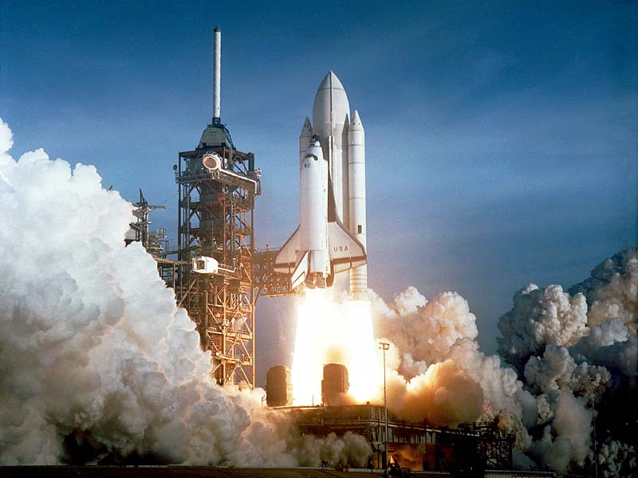
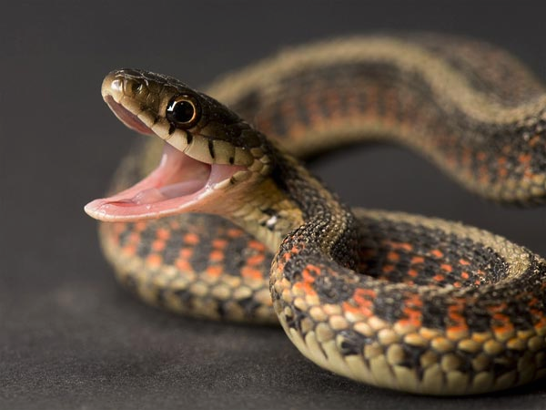
Emotions, Autonomic Arousal & the James-Lange Theory
Common Sense View of Emotion
Emotion:FEAR
Action: Getting as far away as possible
Notes:
You feel an emotion which increases your heart rate and prompts a behavioural response. This is actually the Canon-Bard Theory
Canon was actually a student of William James

Slide 6
Emotions, Autonomic Arousal & the James-Lange Theory
James-Lange Theory
Emotion:
FEAR
Action/Behaviour/Phsyiology
Notes:
You experience emotion in terms of the label you give to your emotional response. You feel fear BECAUSE you run away!

Slide 7
Emotions, Autonomic Arousal & the James-Lange Theory
James-Lange Theory
Event
Appraisal
Action
Emotional Feeling
Notes:
James (1894): You first, quickly appraise the situation as good or bad etc. This leads to an appropriate action such as running away or attacking. This leads to the emotional feeling aspect.

Slide 8
Emotions, Autonomic Arousal & the James-Lange Theory
James-Lange Theory
Predicts that:
People with weak autonomic or skeletal responses will feel less emotion
Causing or increasing someone’s action/response should enhance an emotion.
Notes:
Can test this theory.

Slide 9
Emotions, Autonomic Arousal & the James-Lange Theory
People with weak autonomic or skeletal responses will feel less emotion
People with paralysis through damage to the spinal cord are unable to instigate fight or flight behaviours.
However, most report experiencing emotion at the same level as before their injury (Cobos et al., 2004). But paralysis does not affect the autonomic nervous system so perhaps this is critical in experiencing emotion.
Pure Autonomic Failure: failure of output from autonomic nervous system to the body – no longer regulates heart rate and other organs.
They have little difficulty identifying emotions others might experience but FEEL their emotions less intensively than before
Notes:
Paralysis has little effect, but autonomic failure reduces the EXPERIENCE of emotional intensity.

Slide 10
Emotions, Autonomic Arousal & the James-Lange Theory
People with weak autonomic or skeletal responses will feel less emotion
BOTOX used to paralyse muscles used for frowning to reduce wrinkles in the face. Individuals take longer to read unhappy sentences (Havas et al., 2010).
BOTOX used to paralyse the whole face and people reported reduced emotional responses when watching short videos (Davis et al., 2010).
Patients with Locked-In Syndrome unable to make voluntary facial movements and had problems recognizing other people’s emotional expressions (Pistoia et al., 2010).
Notes:
Paralysis has little effect, but autonomic failure reduces the EXPERIENCE of emotional intensity.

Slide 11
Emotions, Autonomic Arousal & the James-Lange Theory
People with weak autonomic or skeletal responses will feel less emotion
Evidence to the contrary shows that….
People with somatosensory cortex damage had normal autonomic physiological response to emotional music but little subjective experience.
Patients with damage to the PFC had weak autonomic (physiological) responses but normal subjective response (Johnson et al., 2009) .
Not clear whether these reports of emotional experience accurately reflect the FEELINGS aspect of emotion or the cognitive aspect.

Slide 12

Emotions, Autonomic Arousal & the James-Lange Theory
Does causing or increasing someone’s action/response enhance an emotion?
Spontaneous rapid breathing leads to worry about suffocation and panic attacks (Klein, 1993)
Does smiling make you FEEL happier?
A: holding pen in lips uses the frown muscles
B: Holding pen in the teeth uses the smile muscles
Subjects rated a comic strip as funnier when holding the pen in their teeth. (Strack et al., 1988)
A
B
Notes:
The sensation of smiling increases happiness

Slide 13
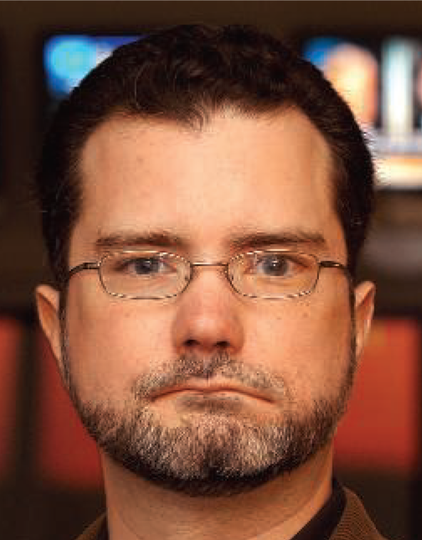

Emotions, Autonomic Arousal & the James-Lange Theory
Does causing or increasing someone’s action/response increase an emotion?
Are smiles necessary for happiness?
Mobius Syndrome
Rare congenital disorder. Infant has problems feeding and exhibits a mask-like expression.
Diagnosis reserved for palsies of the VIth and VIIth cranial nerves and skeletal defects (missing fingers, toes, club foot).
Also problems with eye movements in horizontal plane.
https://www.youtube.com/watch?v=GMwZ2gxnXuI
Notes:
On the left is a reported called Tim McCaughan who claims that his Mobius leads people to take him more seriously than he intended.
Mobius individuals appear to have no problem in processing and experiencing emotion.

Slide 14
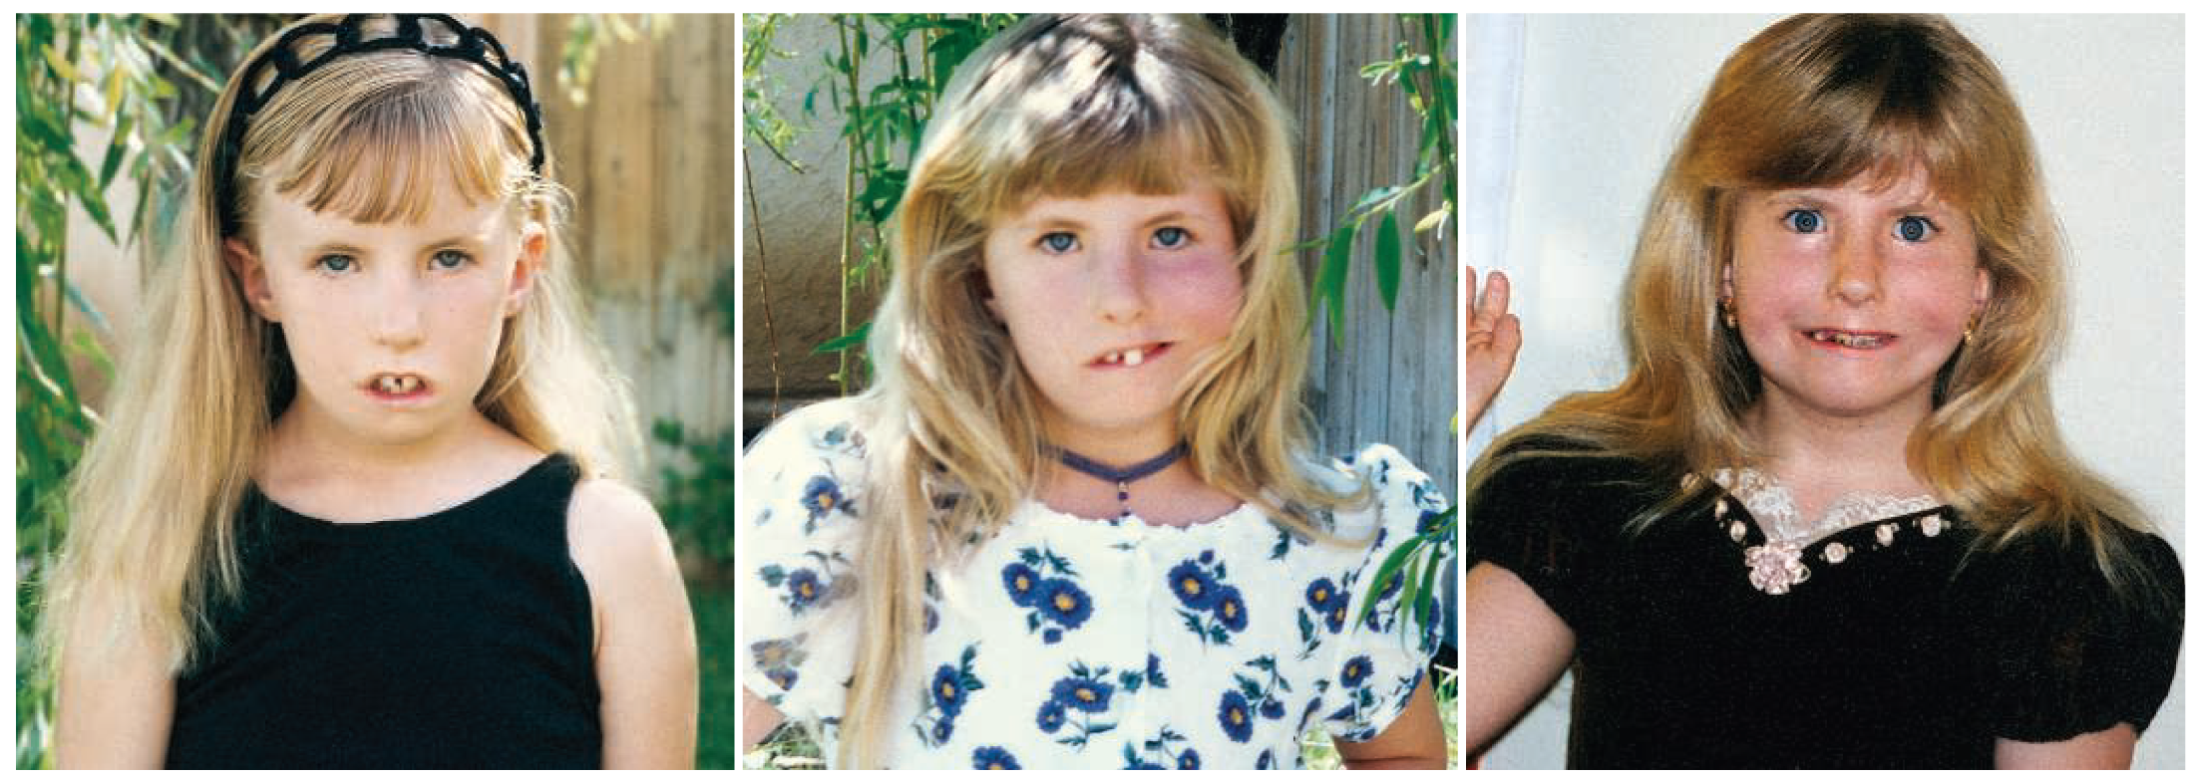
Emotions, Autonomic Arousal & the James-Lange Theory
Do you need to produce emotional to recognise it in others?
Calder et al. (2000) tested 3 MS people and found no impairment in recognizing basic types of facial affect (anger, fear, sad, happy, disgust). They did show mild impairment in face recognition - may be due to problems with eye movements. Suggests that simulation not necessary for facial emotion recognition.
Damasio (1994, 1999) argues that one can bypass the generation stage of producing the expression and utilize the direct modulation of somatic (feeling) structures to simulate.
Notes:
You can see that in the video clip the person certainly does feel emotional!

Slide 15
Emotions, Autonomic Arousal & the James-Lange Theory
Perception of actions can contribute to our emotional feelings just as proposed by the James-Lange theory.
Suggestion that emotions are EMBODIED. That is that they are dependent on bodily responses.
But Walter Canon asks how an action like running might enable us to DIFFERENTIATE between the range of possible emotions.
Cutting the peripheral nerves (from the muscles) does not affect emotion in rats and cats.

Slide 16
Emotions, Autonomic Arousal & the James-Lange Theory
Cannon-Bard Theory suggests that
Stimulus SIMULTANEOUSLY triggers autonomic response AND emotional experience in the brain. Because:
Autonomic nervous system responds too slowly to account for rapid onset of emotional experience. For example, a blush is an autonomic response to embarrassment that takes 15-30 seconds to occur (long after the experience of feeling embarrassed)
People have problems detecting changes in autonomic activity (e.g., heart rate) so how can this lead to a change in the experience of emotion?

Slide 17
Emotions, Autonomic Arousal & the James-Lange Theory
Cannon-Bard Theory suggests that
Stimulus SIMULTANEOUSLY triggers autonomic response AND emotional experience in the brain. Because:
3. If non-emotional stimuli (temperature rise) causes the same pattern of autonomic activity that emotion does then why don’t we feel afraid when we have a fever?
4. Not enough unique patterns of autonomic activity to represent the array of unique emotional experience we have.

Slide 18
Emotions, Autonomic Arousal & the James-Lange Theory
Cannon-Bard Theory vs James-Lange Theory
Schacter & Singer (1962)
James & Lange right to equate emotion with bodily states
Cannon & Bard right to note that there are not enough distinct bodily reactions to account for the variety of emotions we experience.
Different emotions may reflect different INTERPRETATIONS of a single pattern of bodily activity – “UNDIFFERENTIATED BODILY AROUSAL”

Slide 19
Schacter & Singer (1962)
James –Lange Theory
Specific Physiological State
Experience
of Fear
Canon-Bard
Specific Physiological State
Experience
of Fear
Schacter & Singer
General Physiological State
Experience
of Fear
Notes:
Participants given an adrenaline shot but not informed of this “interpreted” their change in physiological state differently. A correctly informed group interpreted their physiological arousal as due to the adrenalin shot, whereas a group who were misinformed about the side effects interpreted their autonomic arousal in the context of a confederate’s behaviour. If he was playful they “felt” happy and if he was aggressive they “felt” angry.

Slide 20
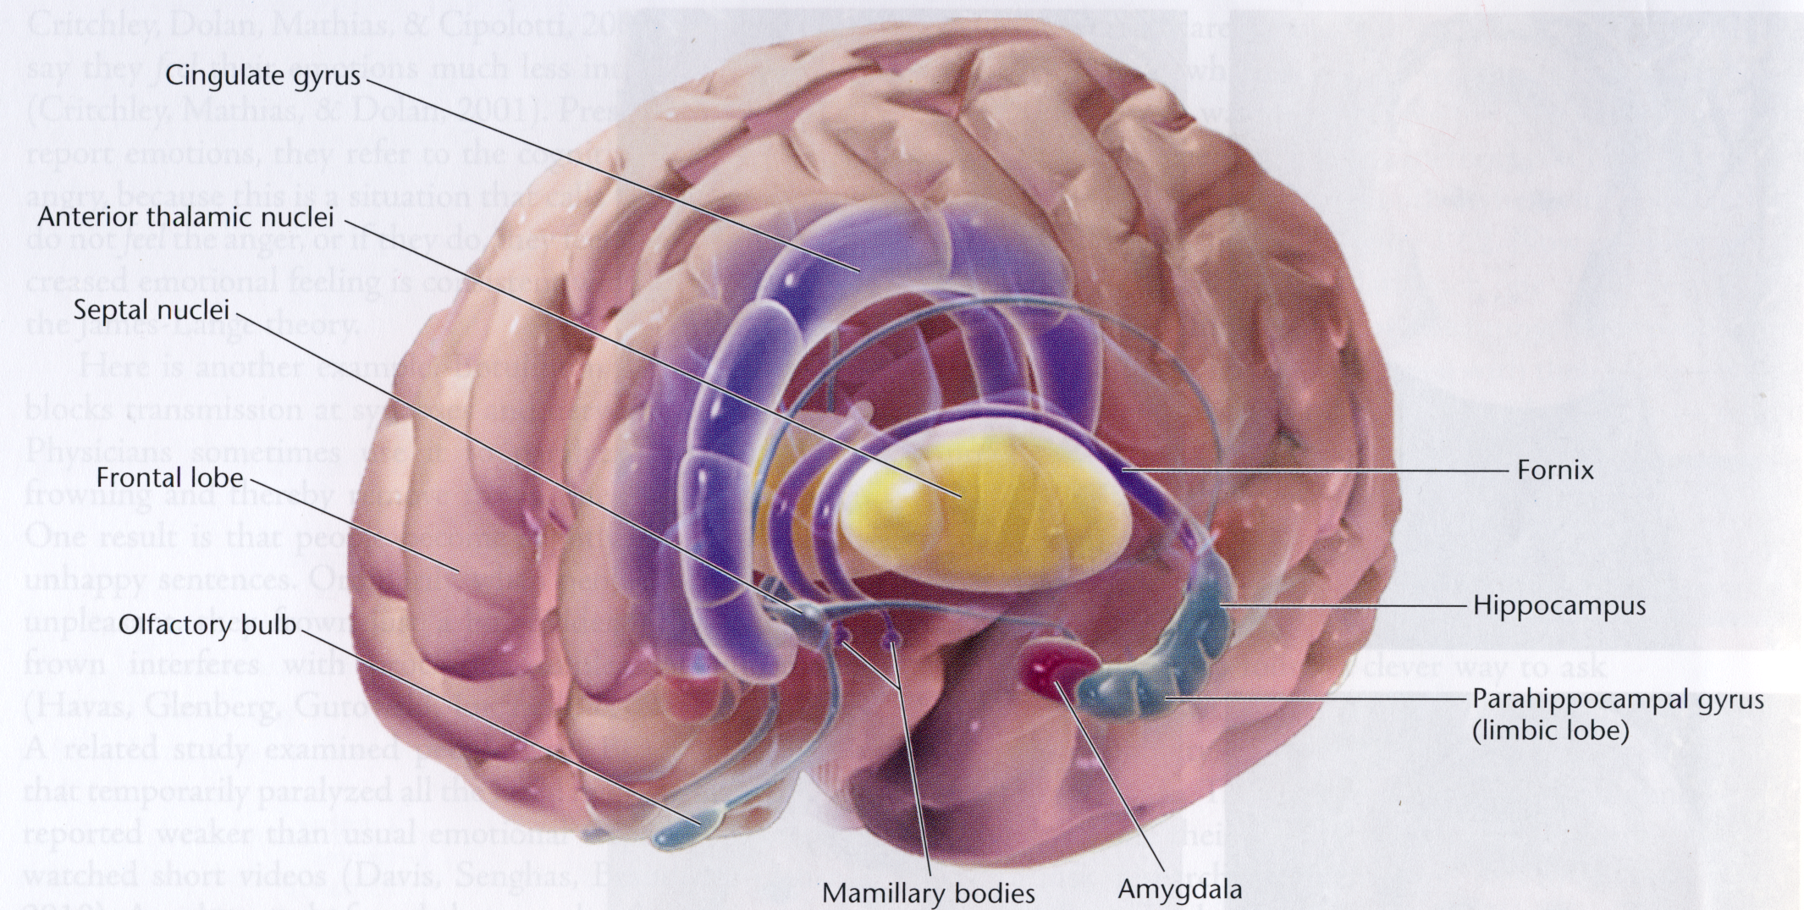
Brain Areas Associated with Emotion
Are specific brain areas related to specific emotions?
Notes:
Some of the areas we will discuss in terms of their role in emotion processing.

Slide 21
Brain Areas Associated with Emotion
Are specific brain areas related to specific emotions?
Notes:
No clear pattern of association between specific emotion and brain area. More variation to do with method than emotion per se (Phan et al., 2002).

Slide 22
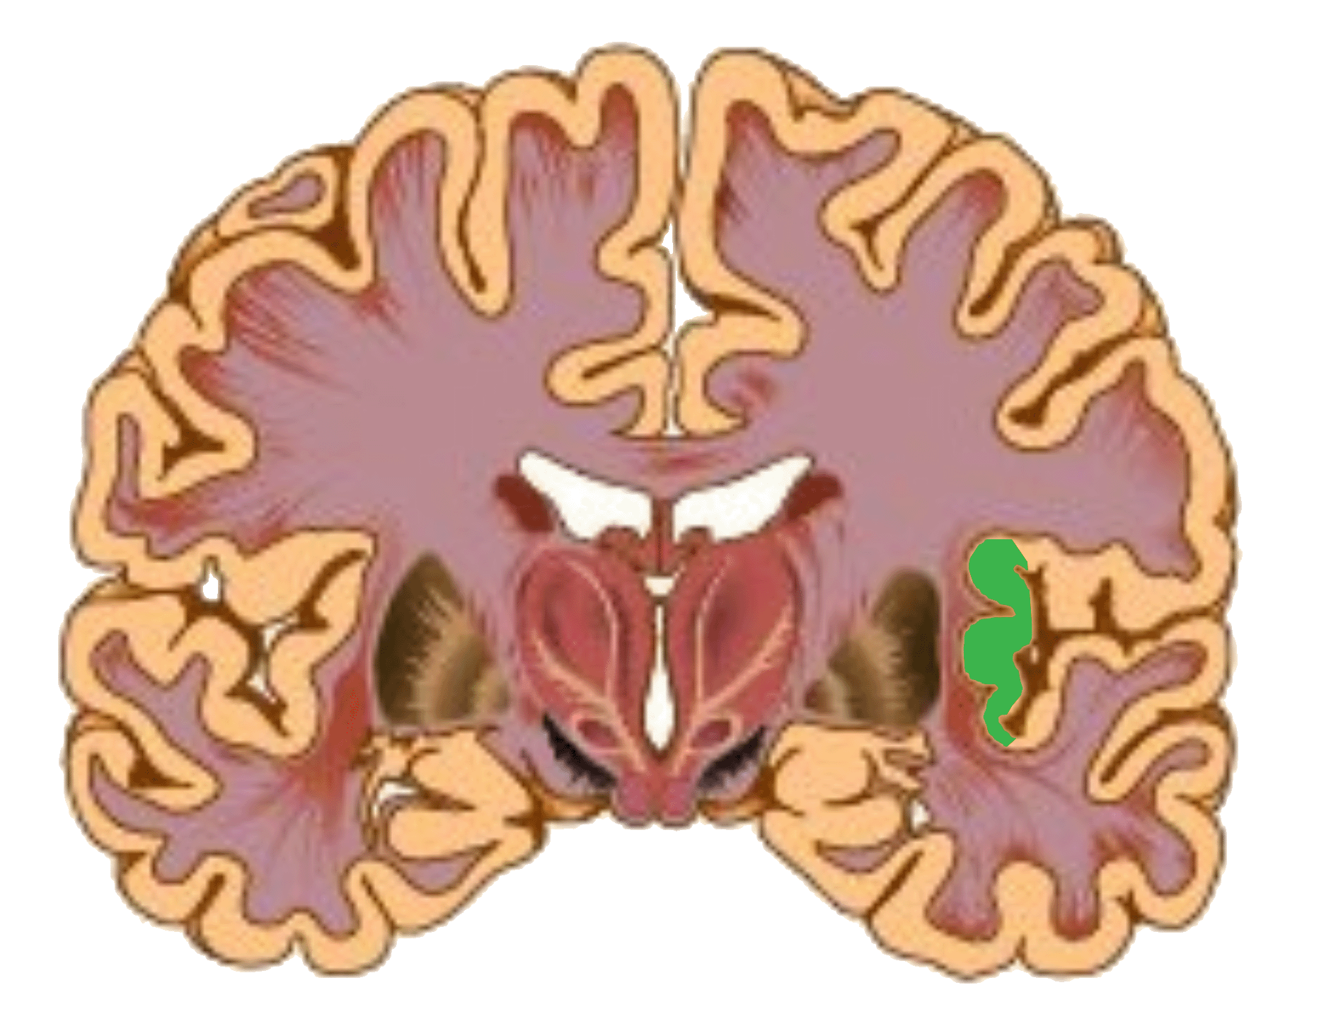
Brain Areas Associated with Emotion
The Insular Cortex & Basal Ganglia and Disgust
Insula
The anterior insula is connected to the ventro–posterior–medial thalamic nucleus, and has been identified in primates as gustatory cortex (Rolls, 1994), containing neurons that respond to pleasant and unpleasant tastes (Yaxley et al., 1988).

Slide 23


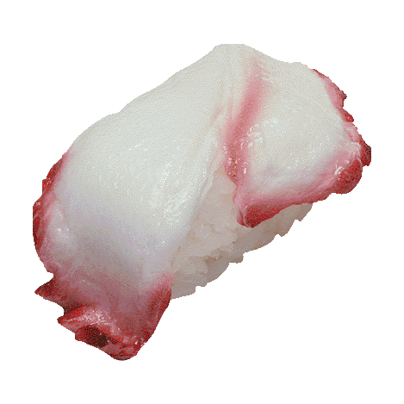
Brain Areas Associated with Emotion
The Insular Cortex & Basal Ganglia and Disgust
Calder et al. (2000) report a patient with damage to left insula and left basal ganglia who was impaired at recognizing disgust in facial expression and in the ability to experience disgust himself.
Adolphs et al. (2002) report a patient with bi-lateral insula damage who was severely impaired at experiencing and recognizing disgust from all types of stimuli.
Insula
Basal
Ganglia
Notes:
Key role for insula experience and recognition of disgust – linked to food perhaps as also responsible for processing taste.

Slide 24
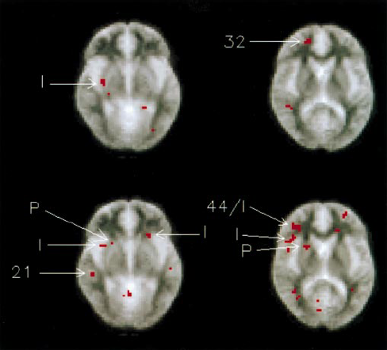
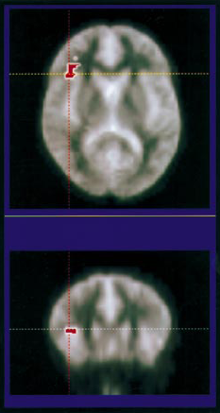
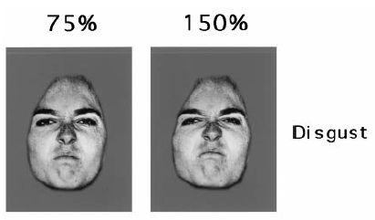
Brain Areas Associated with Emotion
The Insular Cortex & Basal Ganglia and Disgust
75%
150%
Phillips et al. (1997)
150% - 75% shows difference in right anterior insula
Notes:
But….. Insula also responds to scary pictures, angry faces, so not just to items of disgust. Even here there is a case for less specificity in the area-emotion relationship.

Slide 25
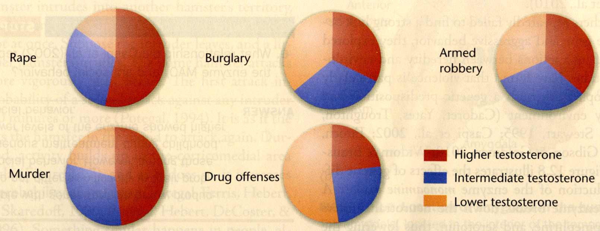
Attack and Escape Behaviours
Hormones
Male hormone TESTOSTERONE linked with social dominance and aggression.
Higher levels of testosterone in violent crime (but not much higher).
Might be large fluctuations between men. Need to test effects in women

Slide 26
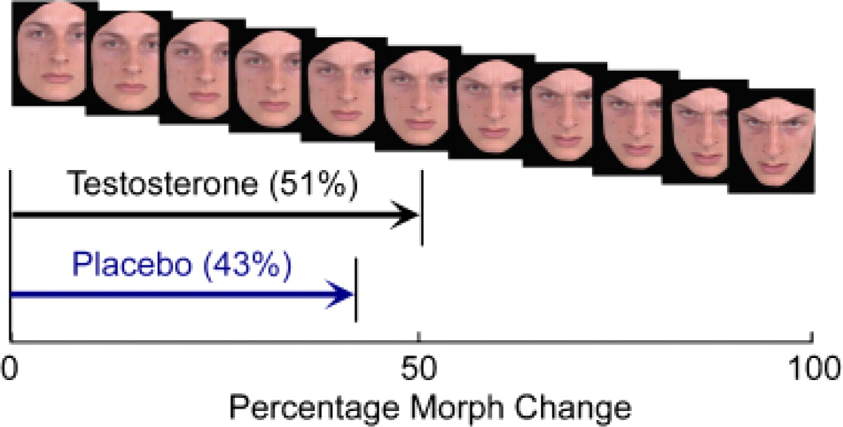
Attack and Escape Behaviours
Hormones
Testosterone delayed conscious recognition of facial threat (anger) signals.
Notes:
Asked to report at which point the face was angry
Testosterone may inhibit the recognition of facial emotion in others and thus lead to escalations in arousal that result in violence.

Slide 27
Attack and Escape Behaviours
Serotonin Synapses & Aggressive Behaviour – Animal Data
Low Serotonin linked to aggressive behaviour.
Serotonin turnover lower in juvenile rats than adults, but aggression levels higher (Taravosh-Lahn et al., 2006).
In 2-year old male monkeys those with the lowest Serotonin turnover had the highest probability of attacking larger monkeys and also incurred the most injuries. All were dead by the age of 6-years from their injuries (Westergaard et al., 2003).

Slide 28
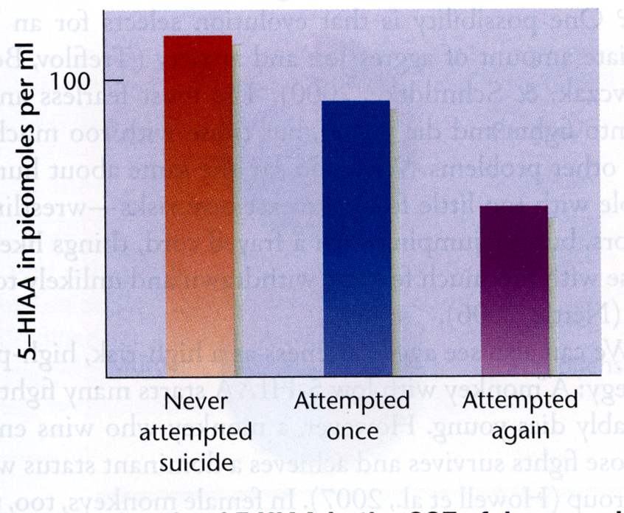
Attack and Escape Behaviours
Serotonin Synapses & Aggressive Behaviour – Human Data
Low Serotonin linked to violent crimes (Vikkunen et al., 1987), and people who attempt suicide by violent means (Roy et al., 1989).
Low Serotonin also a predictor of further convictions for violent crime upon release from prison.
But…. These may represent a non-normative sample. Same effect not always observed in the normal population.

Slide 29
Attack and Escape Behaviours
Serotonin Synapses & Aggressive Behaviour – Human Data
Diet can alter serotonin levels. Serotonin synthesised from amino acid TRYPTOPHAN. Crosses the blood-brain barrier through channels also used by Phenylalanine and other amino acids.
Therefore high concentration of those other amino acids in the diet reduces the amount of tryptophan than can get through which impairs the brain’s ability to make serotonin.
Young men on this diet show increased aggression a few hours after eating (Moeller et al., 1996). Those prone to aggression or suicidal tendencies should avoid diets high in phenylalanine (i.e., stay away from products containing NutraSweet and sweet corn).
Gene that controls the enzyme tryptophan hydroxylase (used to convert tryptophan into serotonin) linked to aggression. Those with less active forms of the enzyme more aggressive (Hennig et al., 2002)
Notes:
NutraSweet is 50% Phenylalanine and maize is high in Phenylalanine and low in Tryptophan.

Slide 30
Attack and Escape Behaviours
But…..
Some on high amino acid diet experience depression, impulsivity and aggression. Those with prior drug problems experience heightened drug cravings.
Serotonin not specific to aggression. Serotonin may perhaps control inhibition. Low levels of serotonin lead to less inhibition (Crocker et al., 2009)
And…..
The brain also seems to release Serotonin during aggressive behaviour and this may actually magnify the behavioural response.
Notes:
Confusing picture.

Slide 31
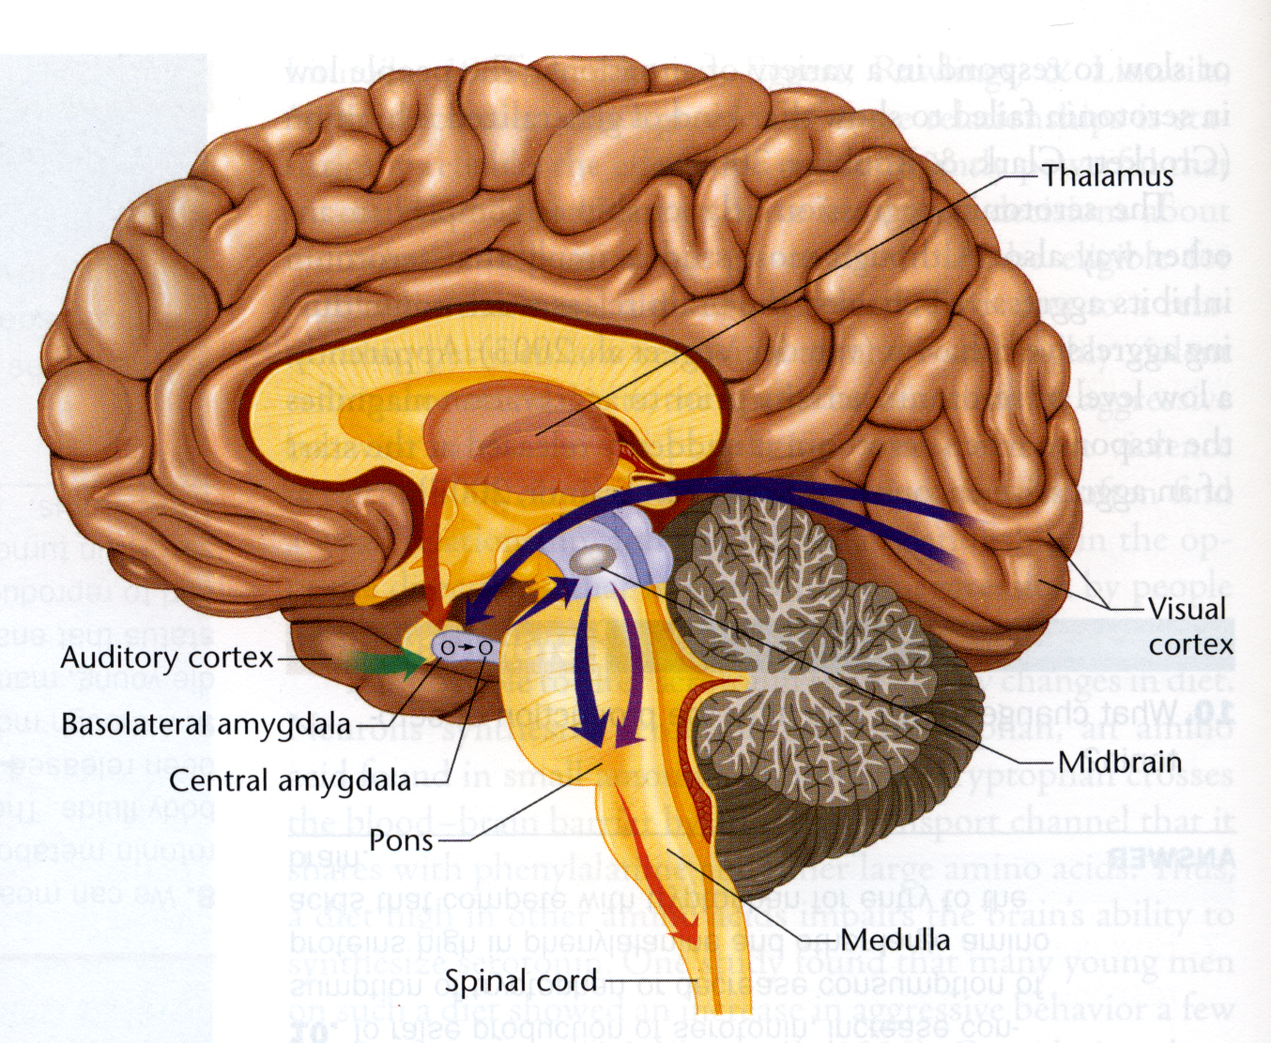
Fear, Anxiety and the Amygdala
Amygdala receives input from pain, vision and hearing centres. Well suited for establishing conditioned responses. Some cells respond to reward and others to punishment.
Projects to hypothalamus which controls autonomic responses (blood pressure) and also to the prefrontal cortex that modulates behaviour.
Also projects to midbrain regions that link to Pons which generates the startle behaviour

Slide 32
Fear, Anxiety and the Amygdala
Animal is presented with a loud noise and a startle response recorded.
A light is then paired with a shock repeatedly.
Finally light precedes the loud noise and increases the startle response.
In rats with amygdala damage there is still a startle reflex but no increase from the light stimulus.
Does damage to the amygdala destroy fear?
No. Suggestion that these animals may have difficulty interpreting signals with emotional consequences.
Notes:
Amygdala might be crucial for INTERPRETING the signals.

Slide 33
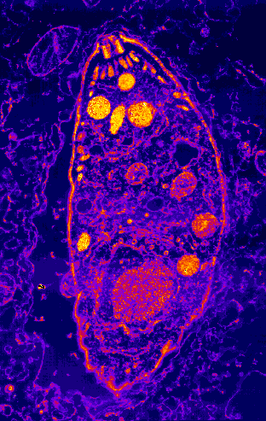
Fear, Anxiety and the Amygdala
Toxoplasma gondii is a parasite that lives and breeds in feline hosts.
The host cat excretes the parasite’s eggs and these then are released into the ground. These infect burrowing animals like rats.
The parasite attacks and damages the amygdala such that the rat shows no fear when approaching cats (perhaps because it fails to interpret the emotional significance of a cat).
The cat eats the rat and so the parasite completes the cycle back into its host.

Slide 34
Fear, Anxiety and the Amygdala
Kluver-Bucy Syndrome
Monkeys with amygdala damage attempt to pick up lighted matches and other objects they would normally avoid. They are also less fearful of snakes and more dominant monkeys.
But……
Others are withdrawn and fearful.

Slide 35
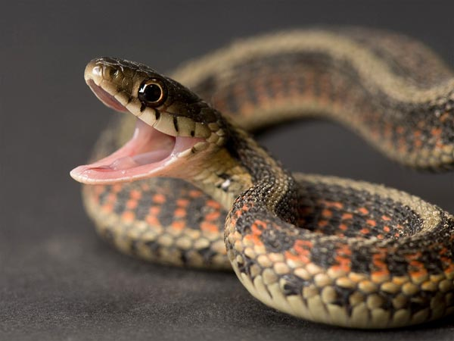

Fear, Anxiety and the Amygdala
In humans the amygdala responds to images that arouse fear or express fear.
But….

Slide 36
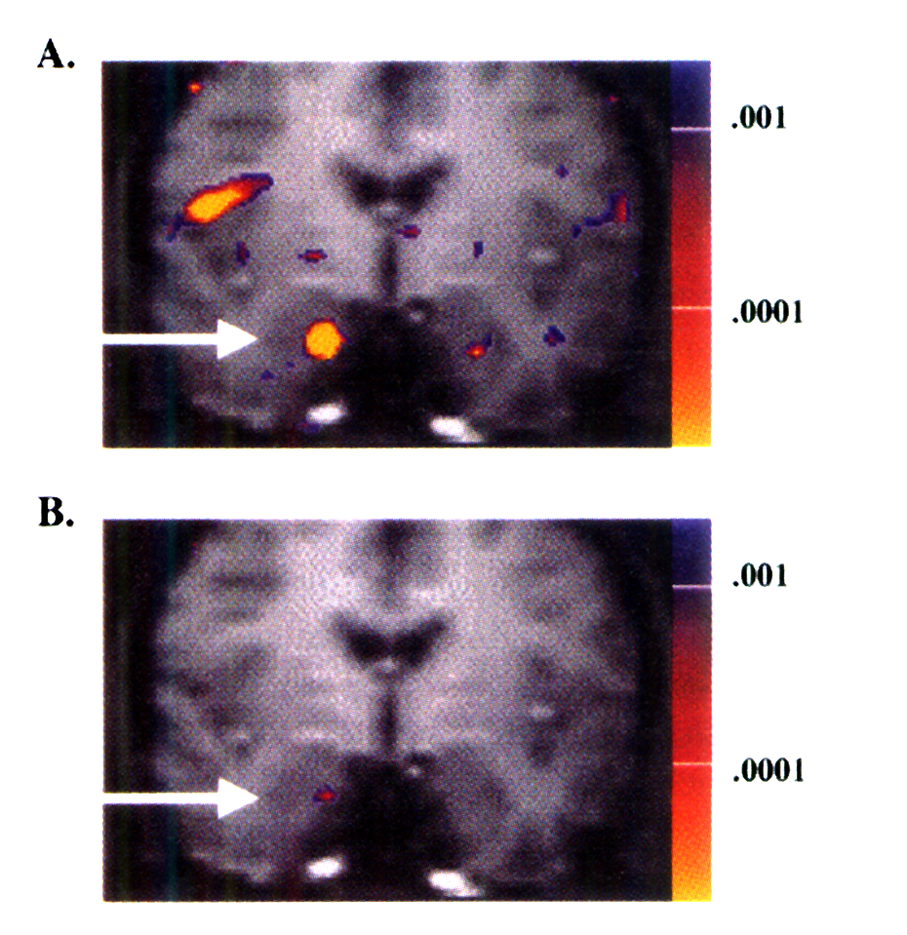
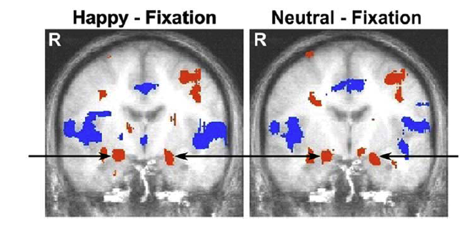
Fear, Anxiety and the Amygdala
A. Comparing Fearful Faces with Neutral Faces shows bi-lateral Amygdala activation.
B. Comparing Angry Faces with Neutral Faces also shows Amygdala activation.
Whalen et al. (2001)
But so do happy and neutral faces!
(Somerville et al., 2004)
Notes:
We can see this on fMRI images.
But the amygdala also responds to other emotions such as happiness as well as neutral facial expressions.

Slide 37
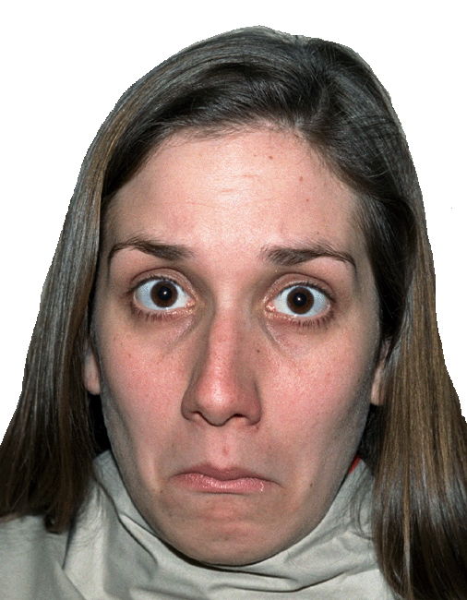

Fear, Anxiety and the Amygdala
Whalen et al. (2001) argue that the pattern of activation found for the amygdala may not reflect the processing of negative emotion/threat per se, but more about detecting ambiguity in the face and how that relates to predictability of the persons actions.
Both convey perceived threat but ANGRY face conveys information about the source of the threat. FEARFUL face conveys ambiguous threat.
Notes:
Recognise an angry expression faster because it is directed towards you.

Slide 38
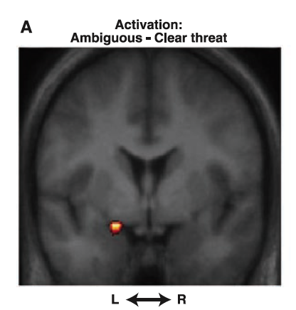
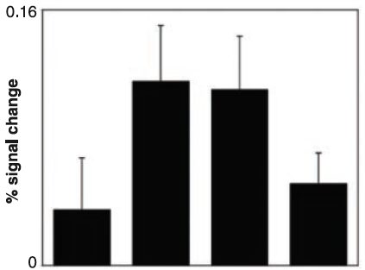




Fear, Anxiety and the Amygdala
Angry face with direct gaze and fearful face with averted gaze are unambiguous. Angry man is angry with ME. Fearful man is scared by something over there so better beware.
Ambiguous

Slide 39
Damage to the Amygdala
Urbach-Wiethe Disease
Individuals with this accumulate calcium in the amygdala and it atrophies.
Patient SM:
Viewed 10 clips from scariest movies and only reports excitement. In spite of stating she hates snakes she was happy to hold a snake. In a Haunted House instead of screaming at monsters she laughed.
Her fearlessness became a danger to her. She was held at gun point, at knife point and was physically abused. When describing the events she expresses anger but not fear.
http://blogs.discovermagazine.com/notrocketscience/2010/12/16/meet-the-woman-without-fear/#.UxtJlfTV_gI
Notes:
If angry person is looking elsewhere the threat is more ambiguous – not angry with me so what is it?
If fearful man is looking at me I’m not scary so where is the threat?

Slide 40
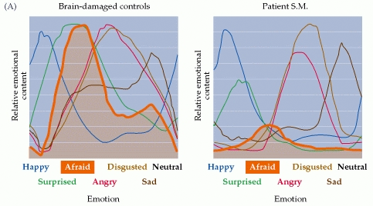
Damage to the Amygdala
Urbach-Wiethe Disease
Most people begin to feel uncomfortable if another person stands within two feet of them. When a male confederate stood nose-to-nose with her she showed and reported no discomfort.
SM fails to recognise FEAR expressed by others.
Notes:
Even when she does recognise it she rates it as less intense than controls.

Slide 41
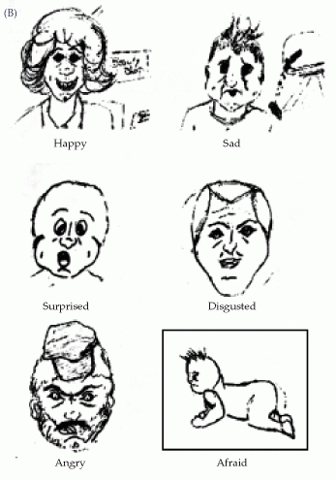
Damage to the Amygdala
Urbach-Wiethe Disease
She can draw most facial emotions with the exception of fear.
When pressed to do so, she draws someone crawling away with their hair standing on end like in cartoons.
SM fails to look at the eyes. For fearful emotions the eyes are very important signals.
Notes:
Says she does not know what fear looks like.

Slide 42
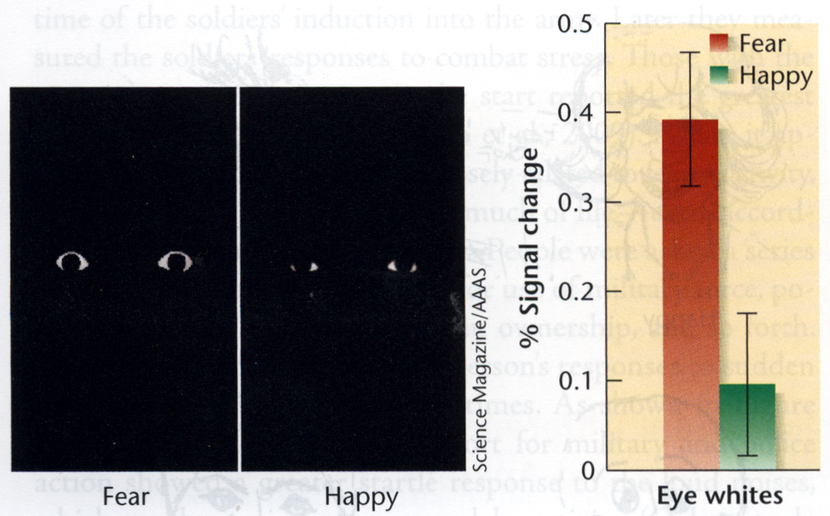
Damage to the Amygdala
Amygdala responds more to fearful than happy eye whites (Whalen et al., 2004). So perhaps the amygdala is responsible for detecting the presence of emotional information and directing other brain areas to pay attention to it.

Slide 43
Reading
Kalat Chapter 12
Schacter Chapter 10
For next week…
Kalat Chapter 13

